Slide 1
HOTEL BOOKING ANALYSIS
CAPSTONE PROJECT
Presented By:
Student Name- IRUTHAYA JEBAS L
Department-Electrical and Electronics Engineering
College-DMI Engineering College

Slide 2
OUTLINE
Problem Statement
Proposed System/Solution
System Development Approach
Algorithm & Deployment
Result
Conclusion
Future Scope
References

Slide 3
PROBLEM STATEMENT
Develop a comprehensive predictive model to determin the optimal timing for hotel room booking, identify the ideal length of stay for obtaining the best daily rates,and predict the likelihood of hotels receiving an elevated number of special requests bases on historical data.

Slide 4
PROPOSED SOLUTION
Utilizing advanced machine learning algorithm,our solution will analyze extensive historical hotel booking data to establish patterns and correlations.
For optional timing, a predictive model will consider factors such as seasonality, demand fluctuations, and promotional periods,providing user with insights on when to secure the most cost-effective room rates.
The ideal length of stay will be determined through data-driven analysis, considering variables like day-of-week trends and duration-specific pricing strategies.
Additionally, a specialized model will predict the likelihood of hotels receiving elevated special request by examining guest profile ,reservation details,and hotel amenities,enabling proactive management strategies for enhanced customer satisfact
This holistic approach aims to empower travelers to hoteliers alike with actionable intelligence for strategic decision-making in the dynamic hospitality landscape

Slide 5
SYSTEM APPROACH
Library Requirements:
1.Data processing and Analysis:
-Pandas: For data manipulation and analysis.
-NamPy: For numerical operations on data.
2.Data Visualization:
-Matplotlib and Seaborn: For creating visualization to understand data patterns.
-Bokeh: Interactive visualization libraries for more complex visualization.

Slide 6
ALGORITHM & DEPLOYMENT
Algorithm Selection
Data Exloration:
Explore the hotel_booking dataset’s structure, features, and target variable(s).
Identify potential patterns, correlations, and outliers.
Proplem Formulations:
Define the problem: Predict optimal booking times,ideal length of stay, and likelihood of special requests based on historical data.
Algorithm selection:
Regression tasks(e.g.,predicting daily rates):
Consider linear regression,decission trees, or ensemble methods(XGBoost,LightGBM).
Classification tasks(e.g.,predicting special requests):
Consider logistic regression,decision,trees,or random forests.

Slide 7
ALGORITHM & DEPLOYMENT
Data Inputs
Data collection:
Gather historical hotel booking data,including information on booking datas, length of stay,special requests,guest profile, and relevant hotel details.
Data Cleaning:
Handle missing values, outliers, and any inconsistencies in the dataset.
Convert categorical variables into numerical representations through encoding techniques.
Feature Engineering:
Create new features or modify existing ones based on domain knowledge.
Extract meaningful information from data variables, Such as day-of-week or month.

Slide 8
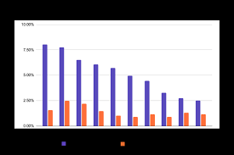
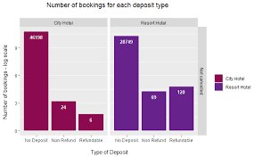
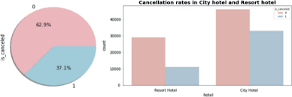
RESULT

Slide 9
CONCLUSION
In conclusion, our proposed solution harnesses the power of advanced machine learning algorithms to transform the hotel reservation process into a dynamic and optimized experience.By meticulously analyzing extensive historical booking data, we unlock patterns and correlations that are pivotal in addressing key challenges faced by both travelers and hoteliers.

Slide 10
FUTURE SCOPE
The proposed solution lays the fundation for ongoing advancements in the realm of hotel reservation optimization. Here are key areas for future exploration and enhancement:
Real-time predictions:
Move towards real-time predictive models that account for instant changes in demand, external events and other dynamic factors to provideusers with up-to-the-minute insights for booking decisions.
Personalization and Customization:
Enhance the predictive models to offer more personalized recommendations by considering individual guest preferences, loyalty history, and user-specific requirements, providing a tailored experience for each travelers.

Slide 11
REFERENCES
https://www.kaggle.com/datasets
https://pandas.pydata.org/pandas-doc/stable/userguide/index.html
https://seaborn.pydata.org/
https://matplotlib.org/stable/contents.html

Slide 12
THANK YOU

